Slide 1
California Renewable Energy:
An Exploratory Analysis & Forecast
By Abraham Huitron

Slide 2
The Data
California Independent Systems Operator (CAISO)
An organization built to maintain the reliability of one of the largest, most modern power grid in the world. They operate a transparent and accessible wholesale energy market, working diligently to meet the electricity needs of its consumers, while at the same time, increasing the amount of renewable energy for the future. (CAISO).
Kaggle Dataset Subset
Date Range: 2010 – 2018
Hourly reports
Various renewable power production sources
Power generated in megawatts (MW)

Slide 3
Data Detail
Variable Name | Description
TIMESTAMP | The date/time of the record. (YYYY-MM-DD hh:mm:ss)
BIOGAS | The amount of power generated by biogas. (MW)
BIOMASS | The amount of power generated by biomass. (MW)
GEOTHERMAL | The amount of power generated by geothermal. (MW)
Hour | The hour of the day. (24 HR)
SMALL HYDRO | The amount of power generated by small hydro. (MW)
SOLAR | The amount of power generated by solar. (MW)
SOLAR PV | The amount of power generated by solar photovoltaic. (MW)
SOLAR THERMAL | The amount of power generated by solar thermal. (MW)
WIND TOTAL | The amount of power generated by wind. (MW)

Slide 4
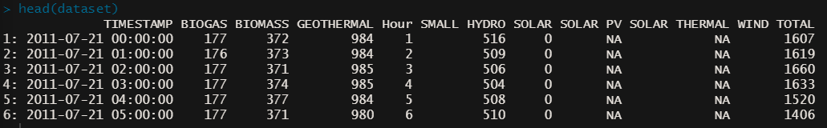
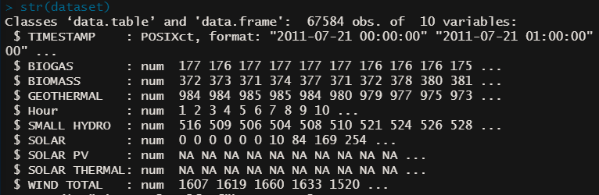
Data Preview
Columns | Rows
10 | 67,584

Slide 5
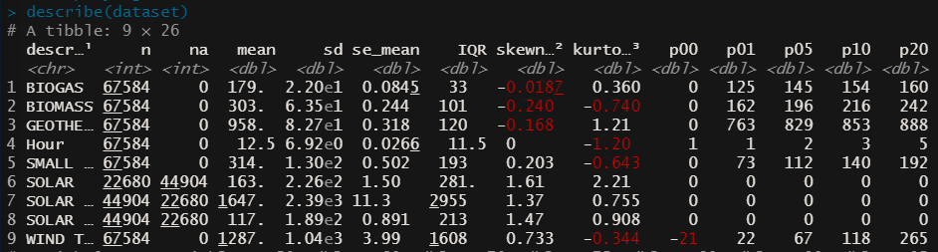
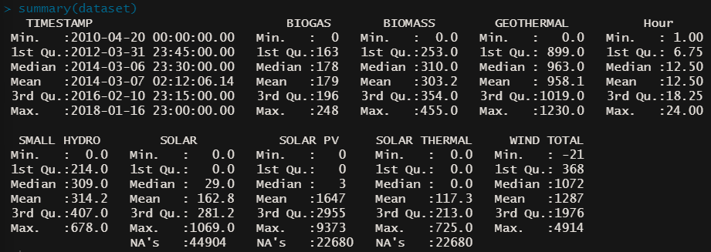
Data Preview Cont. (Statistics)

Slide 6
Questions?

Slide 7
Questions?
What can this data tell us about the production of renewable energy over the given period?
Is there seasonality? Is it daily? Monthly? Yearly?
Which methods of energy generation are used most?
Different methods generate at different speeds.
Which methods appear to be growing vs. declining? Why?
More adoption? Cheaper operating costs?
Can we predict/forecast the values of future time periods?
Why would we want to know this value?

Slide 8
Renewable Energy #1 - Biogas
Biogas a mixture of gases, consisting of methane, carbon dioxide and hydrogen sulphide, produced from raw materials such as agricultural waste, manure, sewage, and others.

